Slide 1

Acknowledgement of Receipt 3.0
Jonas Bucksch & Manuel Naujoks

Slide 2
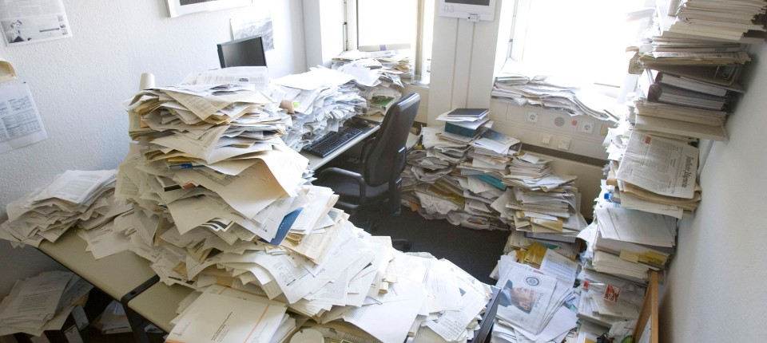
https://media0.faz.net/ppmedia/aktuell/wirtschaft/777415979/1.1528426/format_top1_breit/wo-ist-noch-mal-die-rechnung.jpg

Slide 3
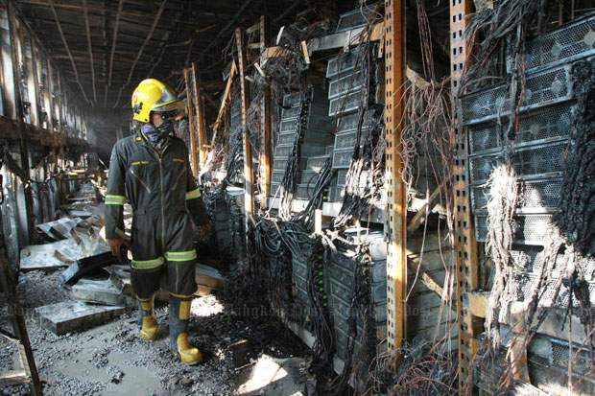
https://www.bangkokpost.com/media/content/20141014/694349.jpg

Slide 4
Our mission is to enable our
partners
to benefit from
modern technology.
customers
colleagues
Mobile, Cloud
AI, Blockchain, …

Slide 5
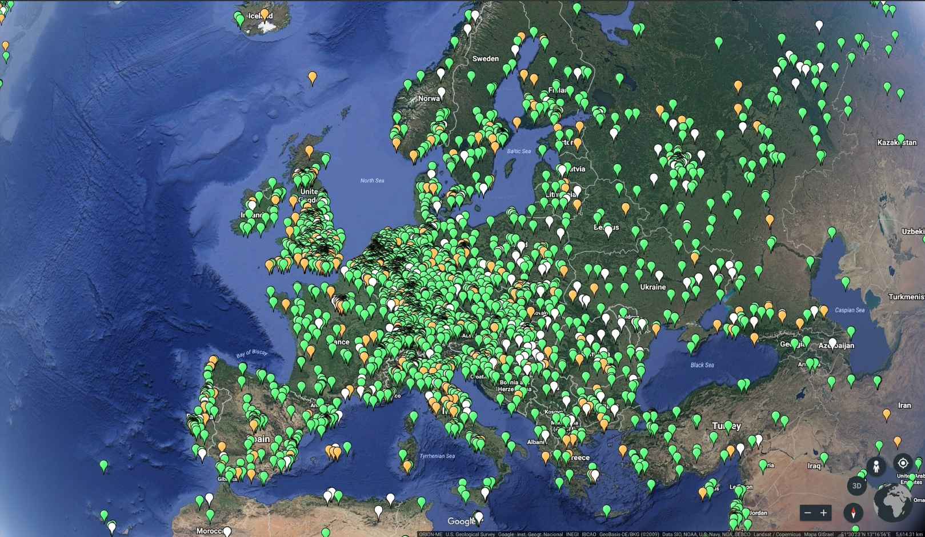
Acknowledgement of Receipt 3.0
DAPP on Ethereum

Slide 6
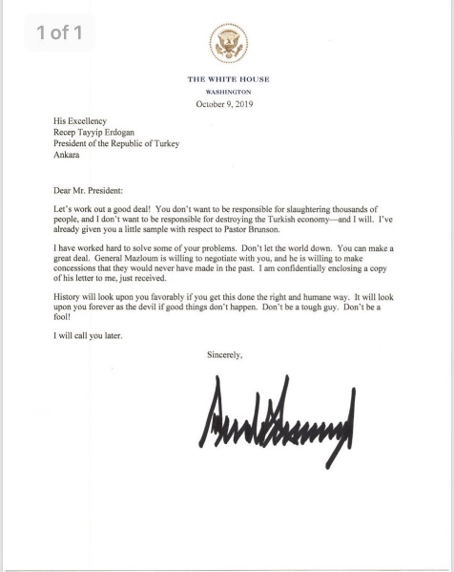
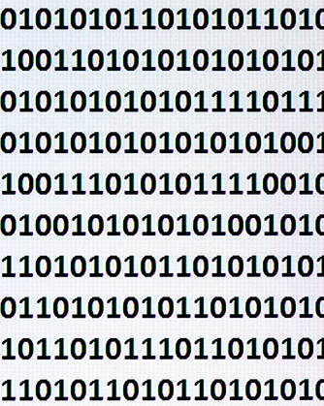

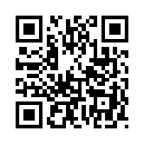
Random +
SHA3
Document Link

Slide 7
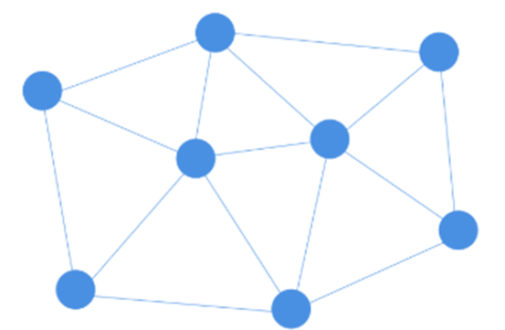



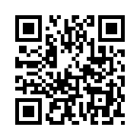


Slide 8

Summary
Secure, decentralized, tamperproof code that everybody can use.
Reliable, undeniable and transparent tracking of physical and digital information exchange.
Eternal.

Slide 9

More Ideas
Drawbacks
public Ethereum requires incentives for miners (gas = money)
reintroduce a trustable consortium
public Ethereum latency until transactions are confirmed
reintroduce a trustable consortium
complicated ALM of smart contracts
Monetization?
ICO coming soon ☺

